Slide 1
Marine Biotechnology:
Biotechnology Beneath the Waves
Group 6 members:
Arannya (HS24510063)
Saneth (HS24510206)
Piyushani (HS24510135)
Irushi (HS24510223)
Shenthuri (HS24022224)
Michelle (HS24510297)

Slide 2
Table of Contents
Introduction and significance
Applications of Marine Biotechnology
Aquaculture and fishery
Biomedical and Pharmaceutical
Biomaterials
Biofuel
Ocean conservation and Environmental protection
Conclusion
References
Outro

Slide 3
Introduction and significance
What is Marine Biotechnology?
The creation of products and processes from marine organisms through the application of biotechnology.
It is also sometimes called “Blue biotechnology”.
It is an exploitation of the diversity found in marine environments.
Why is Marine Biotechnology
important?
Biodiversity utilization
Understanding climate change
Conservation and Management

Slide 4
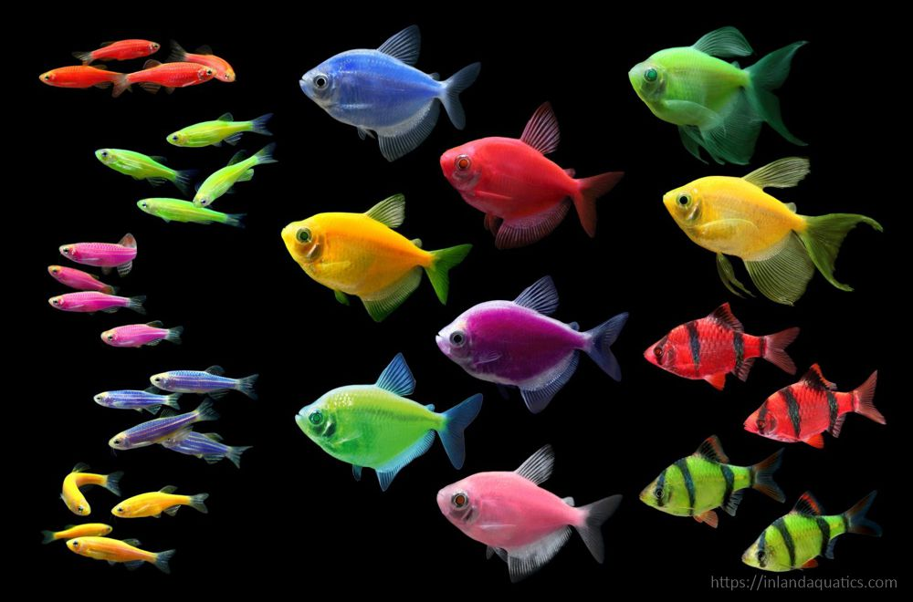
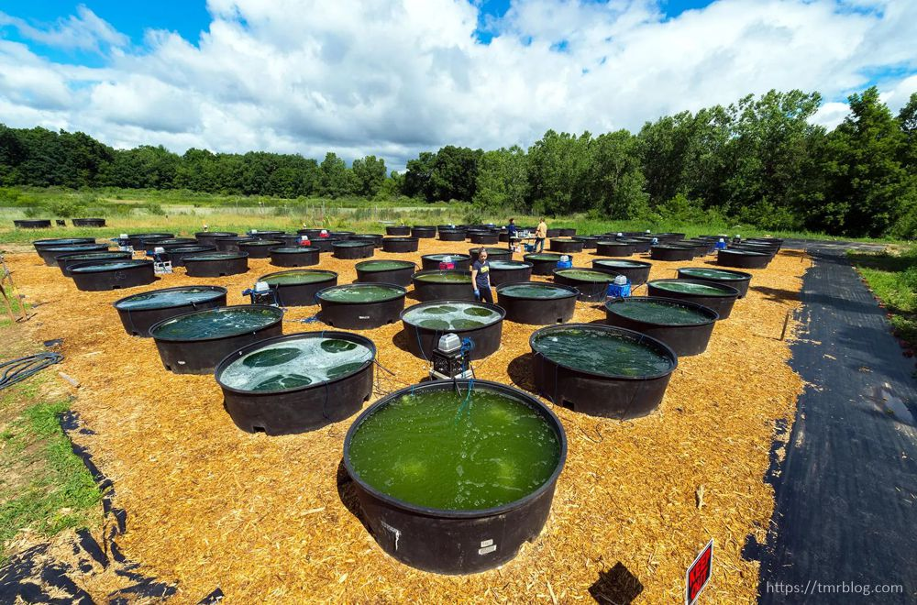
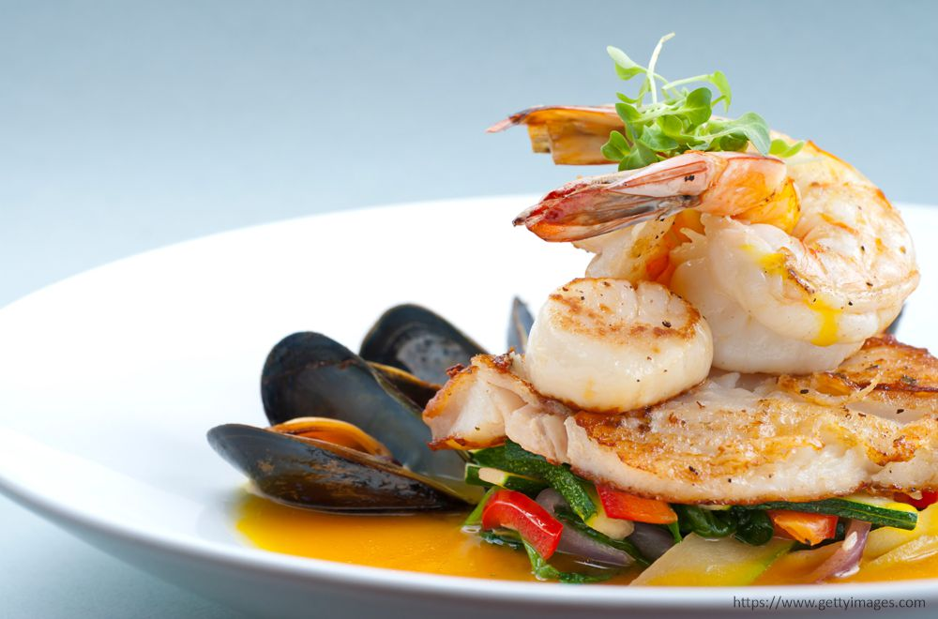
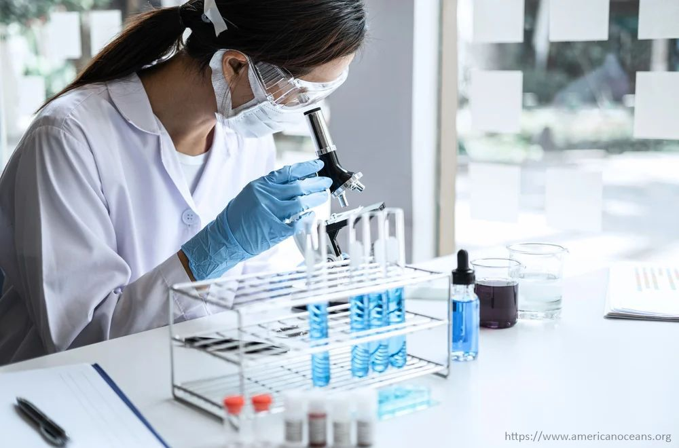
Aquaculture and fishery
Aquaculture: The controlled farming of aquatic organisms
such as fish, crustaceans, molluscs, algae, and other plants.
For what?
Food
Research
Industry
Hobby
Ornamental value

Slide 5
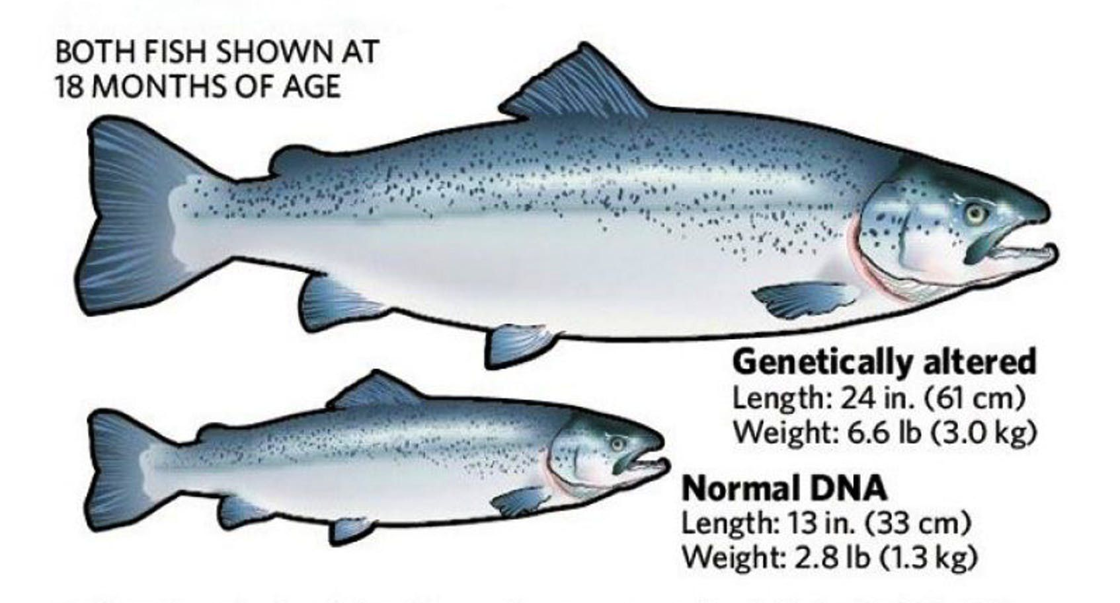
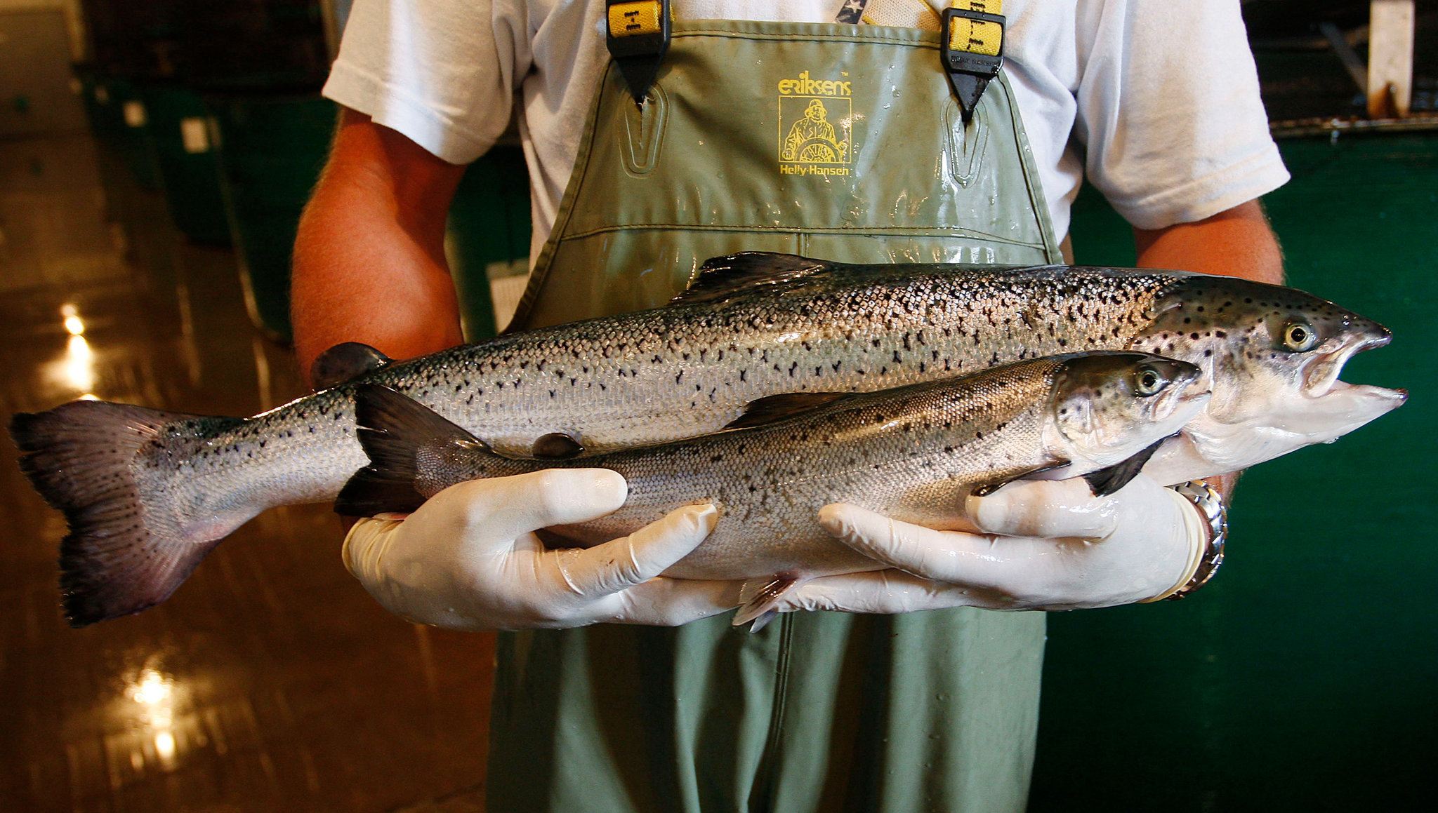
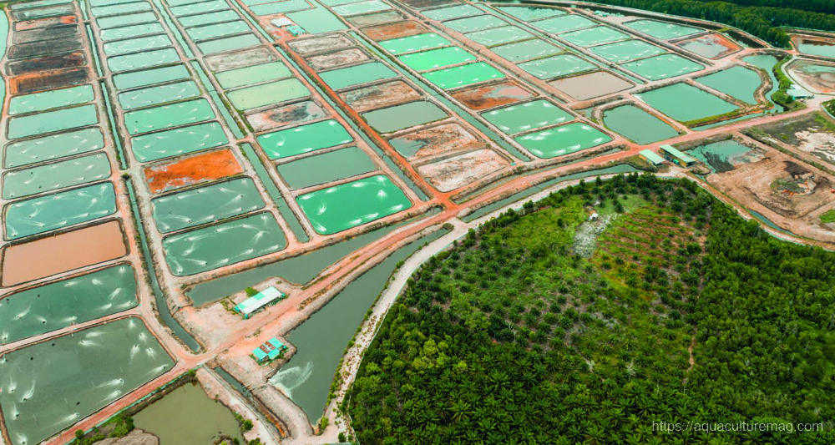
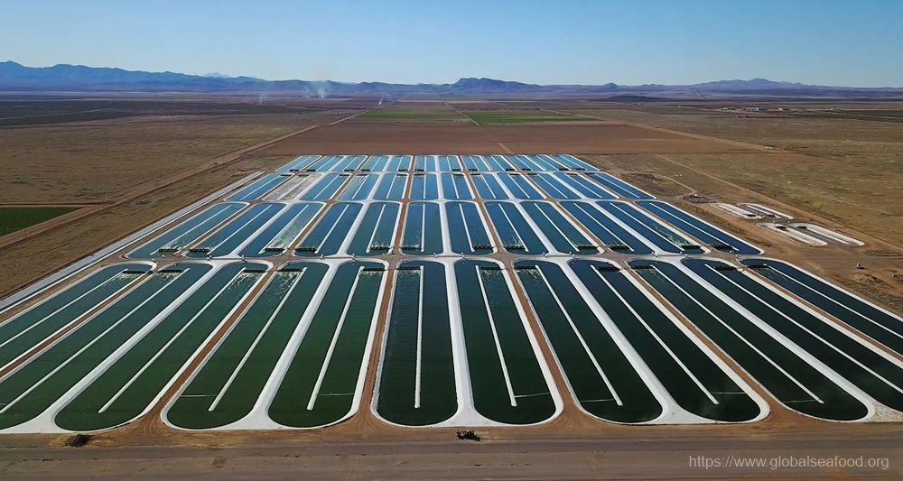
Aquaculture and fishery
Transgenic fish resistant to extreme cold.
Faster growing, bigger fish (AquAdvantage® salmon).
Shrimp resistant to viral diseases.
Algae farming for biofuels, bioplastics, cosmetics, food/feed, and medicine.
Carnivorous fish who can absorb nutrients from plant-based feed.
Fish vaccines.

Slide 6
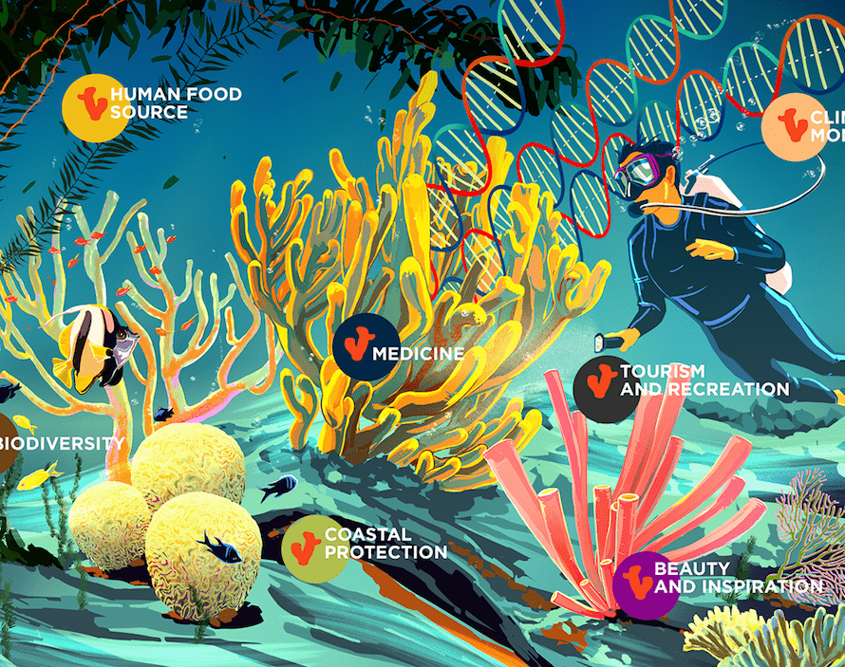
Exploring the transformative potential of Marine Medicine
Marine biotechnology in disease diagnosis
Marine biotechnology in medical field on industrial basis

Slide 7
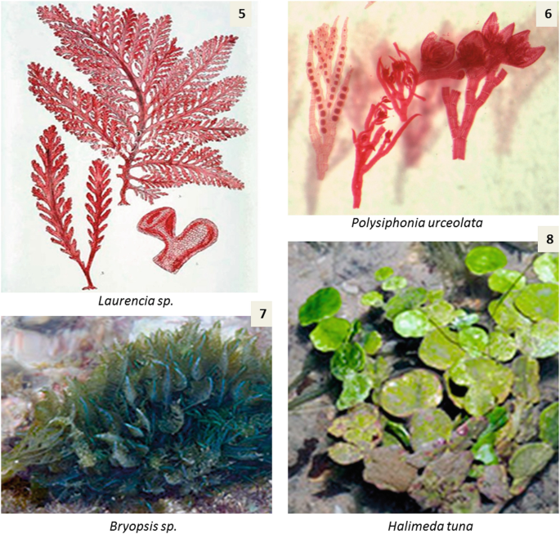
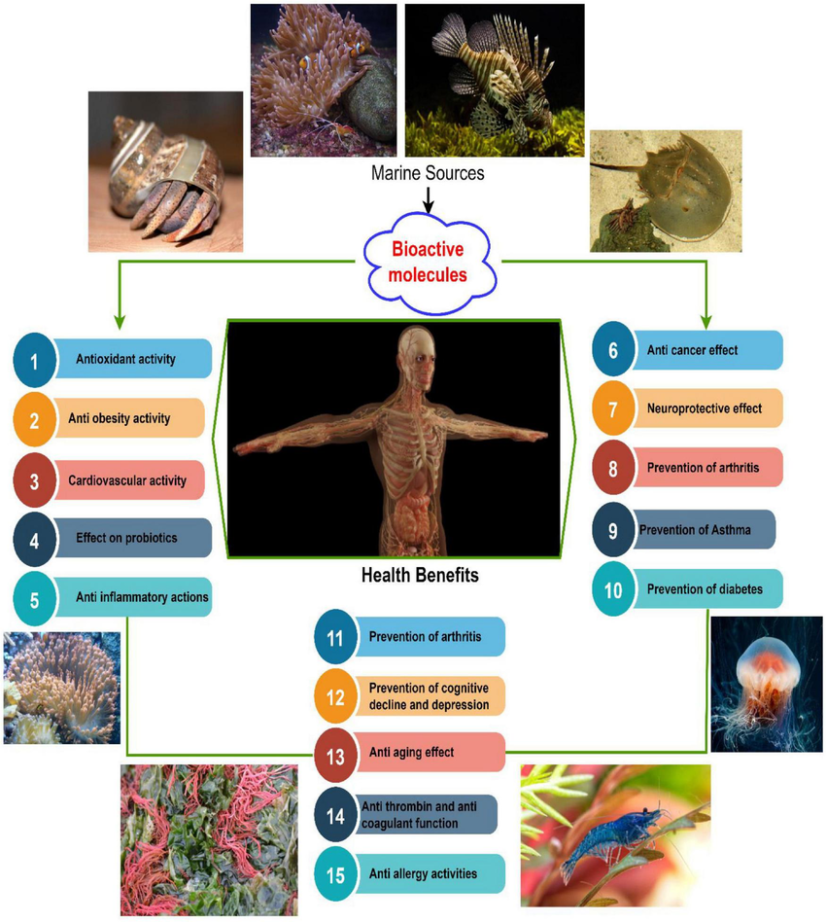
Unlocking ocean secrets of Marine Medicine
Marine plants with a medical value
Marine organisms with a medical value

Slide 8
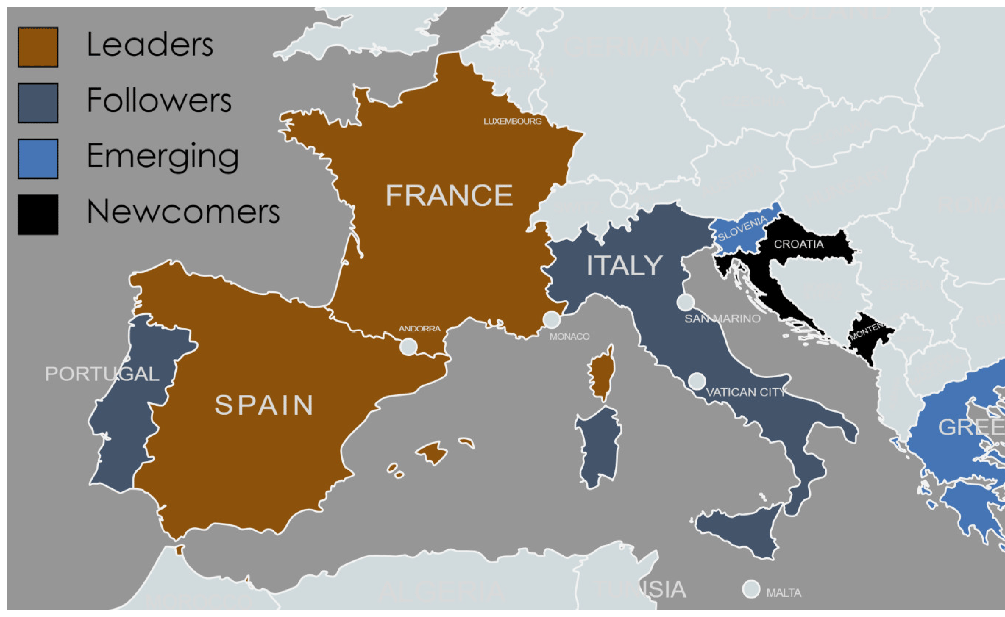
Industrial basis of Marine Biotechnology in the field of Medicine
Leading countries:
France
Spain
Newly added countries:
Croatia
Montenegro

Slide 9
Biomaterials
Biomaterials means, the things extracted from
marine organisms or their byproducts.
We can use them in various fields:
Medicine
Environmental science
Industry

Slide 10
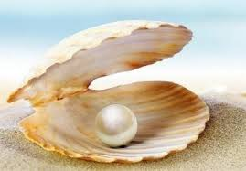
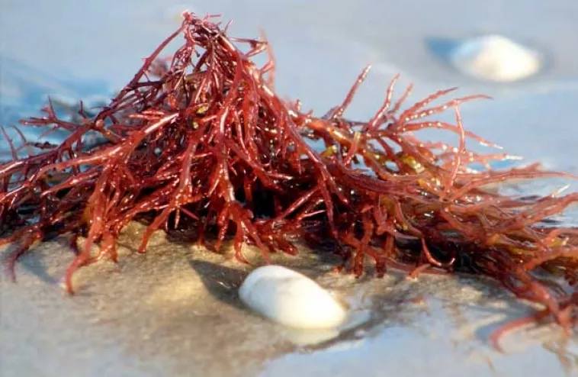
Biomaterials
Chitosan
Wound healing
Tissue engineering
Food industry
Agar
Microbiology
Cosmetics industry
Tissue culture
Medicine
Pearl
Jewellery
Cosmetics
Alginates
Medical sector
Food industry
Cosmetics
Industrial applications

Slide 11
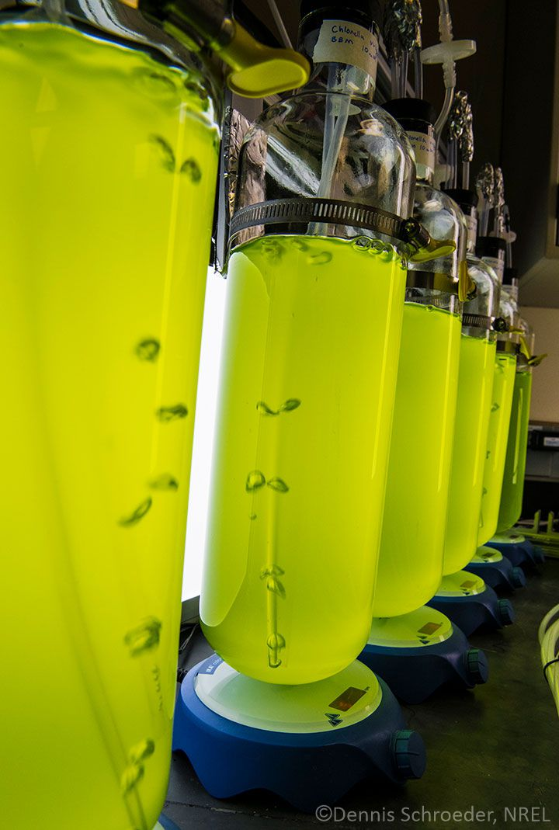
Biofuel
Marine biotechnology uses algae and seaweeds to produce biofuel.
Algae benefits:
Grows quickly
High oil content
Can be grown in the ocean
Production process:
Cultivation
Efficient harvesting
Oil extraction
Conversion to biofuels

Slide 12
Biofuel
Sustainability:
Renewable and sustainable
Lower carbon footprint
Doesn’t compete with food crops for land
Advantages:
Cost
Renewability
Source material
Challenges:
High production cost
Technological barriers
Scalability issues
Outlook:
Advances in genetic engineering
Combining biofuels with wastewater treatment
Growing interest and investment in the field

Slide 13
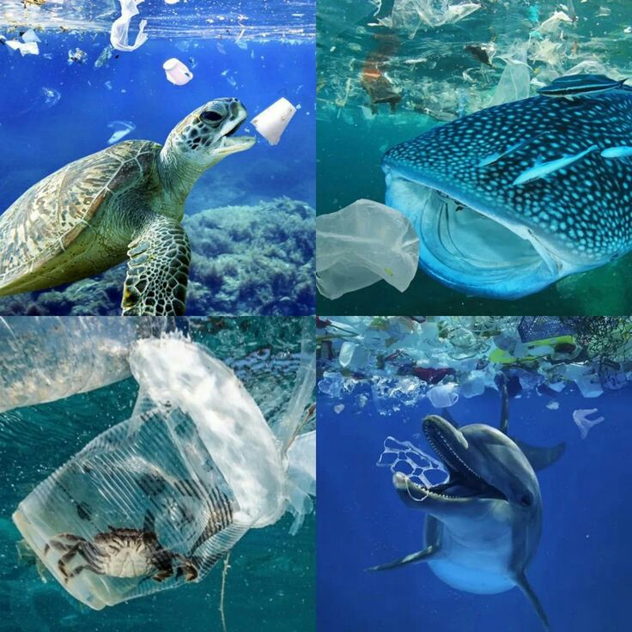
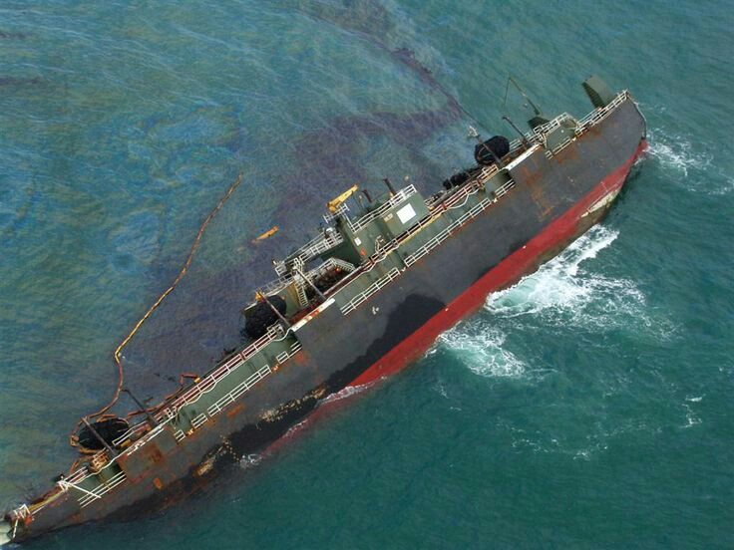
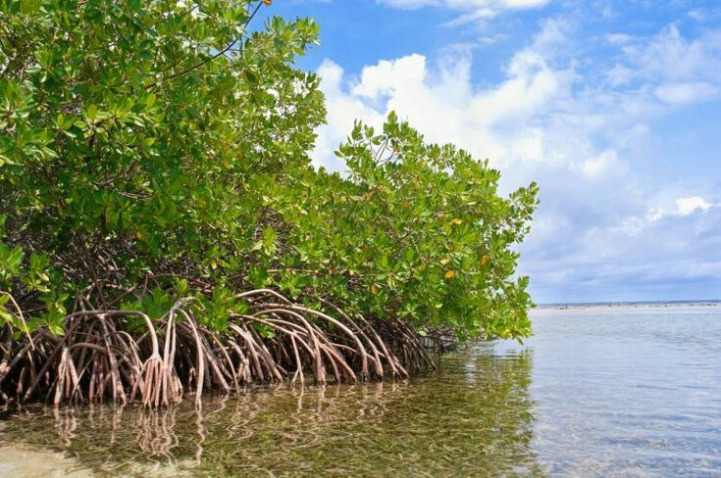
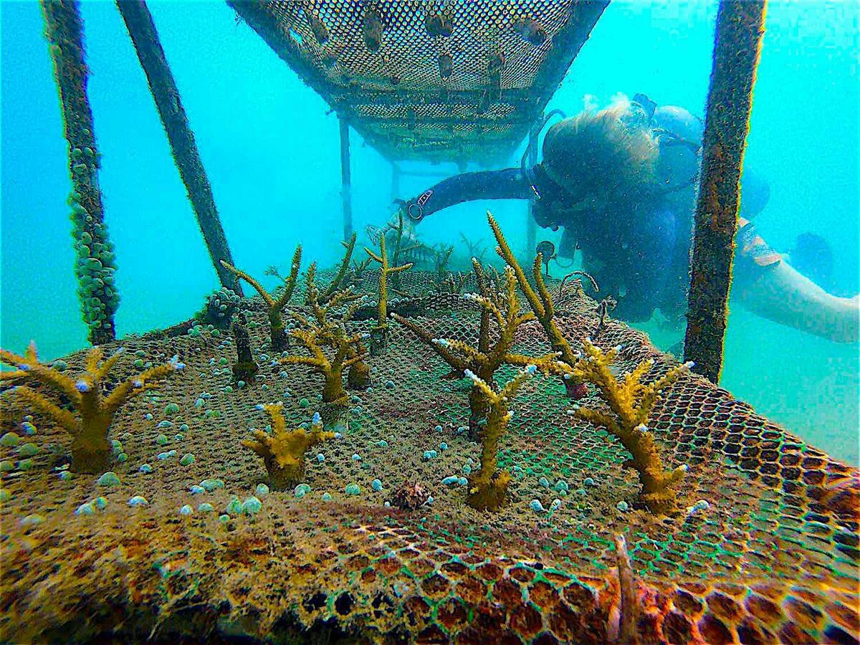
Ocean conservation and environment protection
Bioremediation:
Alcanivorax bacteria:
Degrades crude oil into less harmful compounds.
Restoration of marine habitats:
Micro-fragmentation:
To restore damaged coral reefs, improving growth rates.
Marine-derived enzymes:
Can break down non-degradable plastics.
Tissue culture techniques:
To breed mangrove ecosystems.

Slide 14
Ocean conservation and environment protection
Sustainable aquaculture:
Genetic engineering:
To create faster-growing fish.
Vaccines:
Against diseases (sea lice and viral infections) to improve fish health.
Monitoring and assessment:
Marine-derived biosensors: Detects toxins, Water quality can be monitored in real time.
Genetic barcoding:
To identify marine species and assess biodiversity.

Slide 15
Conclusion
Marine Biotechnology is helpful for:
Biodiversity utilization in food, medical, cosmetics, materials and production, and fuel industries.
Conservation and management of the aquatic and other environments.
Conservation and management of aquatic organisms.

Slide 16
References
Lien, D. (2023). Applications of Marine Organisms in Medicine and Pharmaceuticals. Biology and Medicine, 15(11), 1000620. https://doi.org/10.35248/0974-8369.23.15.620.
Marine Biotechnology | ISAAA.org. (n.d.). https://www.isaaa.org/resources/publications/pocketk/52/default.asp#:~:text=Marine%20biotechnology%20is%20the%20creation.
Ocean Genomics Horizon Scan | Revive & Restore. (2021, December 3). Revive & Restore. https://ocean.reviverestore.org/.

Slide 17
Thanks!

